Slide 1

ArUco Tag Follower
Lucas Plant, Will Langley, Kanussh Jain, John Matthews

Slide 2
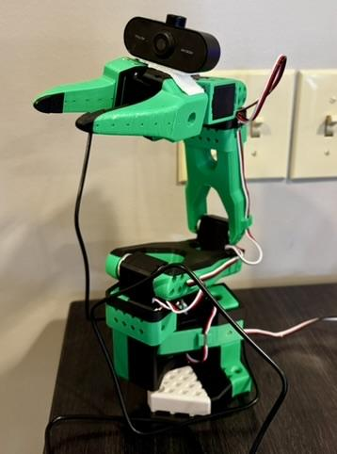
Intended Behavior
Use “Visual Servoing” to have the manipulator follow an object
Bring ArUco tag into view
Move ArUco tag
End effector moves with 2 objectives
Keep the ArUco tag in view of the camera using rotation
Follow the position of the tag (with an offset) using translation

Slide 3

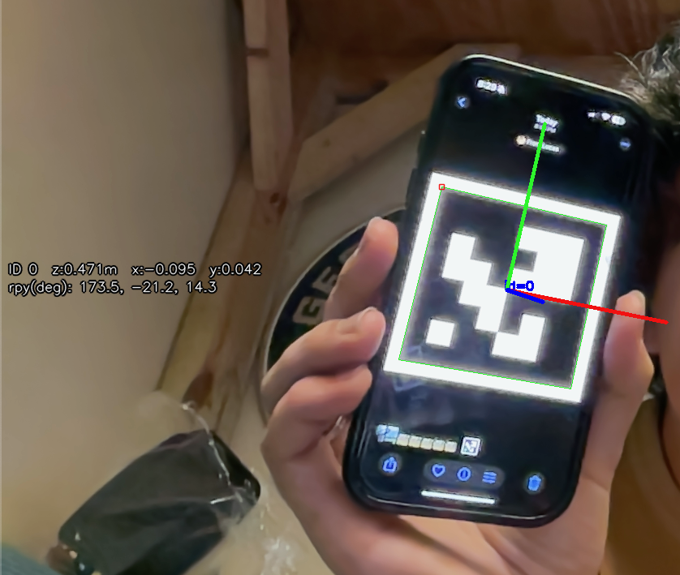
Procedure
Sample a frame from the camera
Compute the difference in the ArUco tag orientation and the current orientation
Use forward kinematics to derive pseudo-inverse Jacobian
Use resolved rate to determine the next joint angles
Move to the desired joint angles
Repeat with next frame

Slide 4
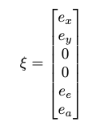
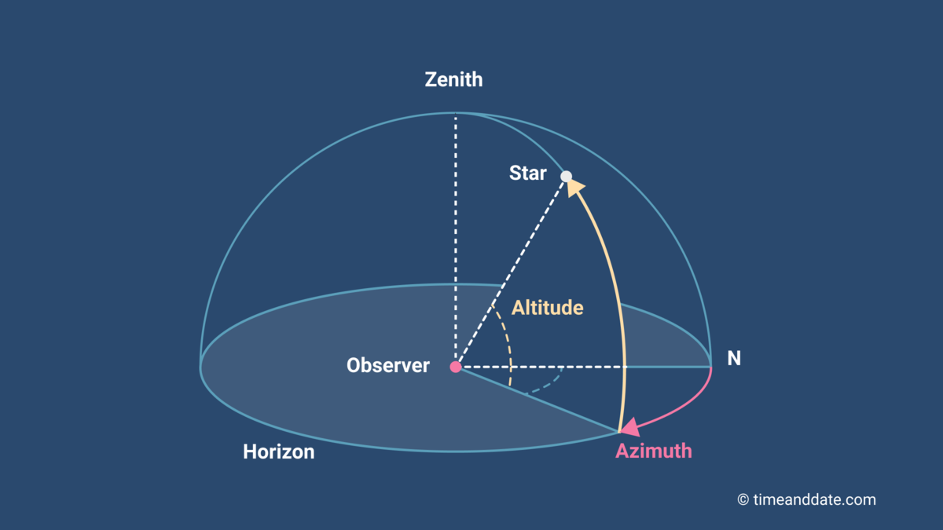
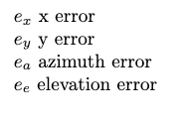
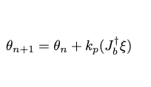
Resolved Rate for Visual Servoing
Determine target twist in the end effector or camera frame based on the error
Move in the direction of the desired twist using the damped inverse jacobian

Slide 5
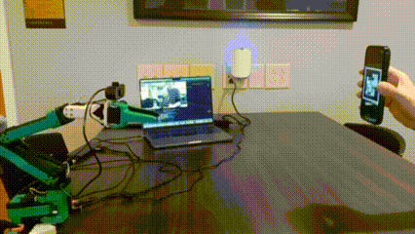
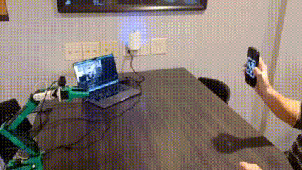
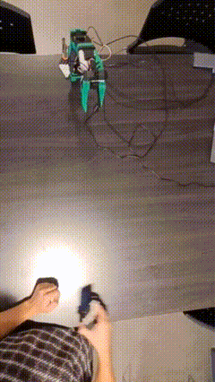
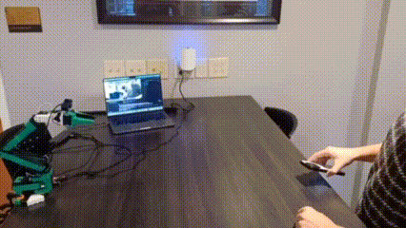

Slide 6
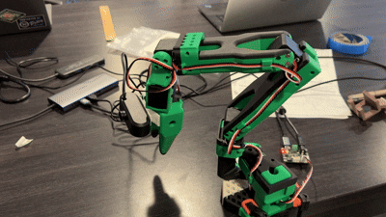
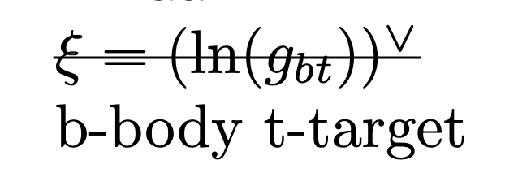
Technical Challenges
Low camera quality
Motion blur
Frame rate
Rolling vs global shutter
Jerky movement
Losing tag from movement
Pose resolution was slow restricting control rate
Kinematic constraints of the robot
Full pose tracking is impossible as the requested pose may be outside of the workspace
Specifically yaw is impossible due to lack of wrist swivel
Instability due to gains

Slide 7
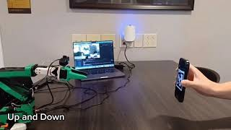

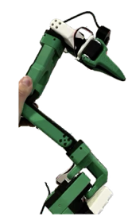
Thank You for Listening!
https://youtu.be/sU2IApv3Ekg?si=8Va_pyqXZPuSU5c5

Slide 8
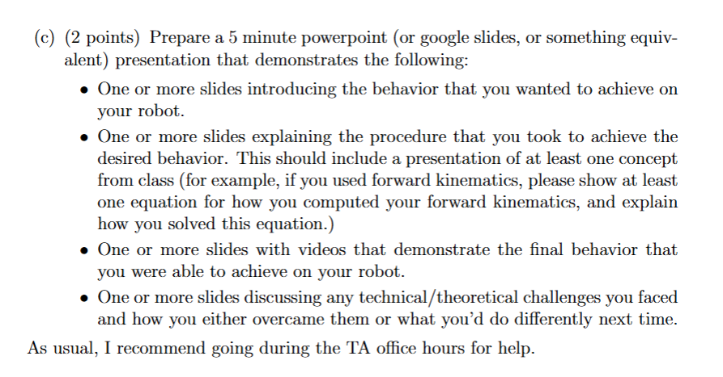

Slide 9
